Slide 1
Map Analysis and Modeling in Forestry’s Future: …where we are headed and how we can get there
Joseph K. Berry

Slide 2
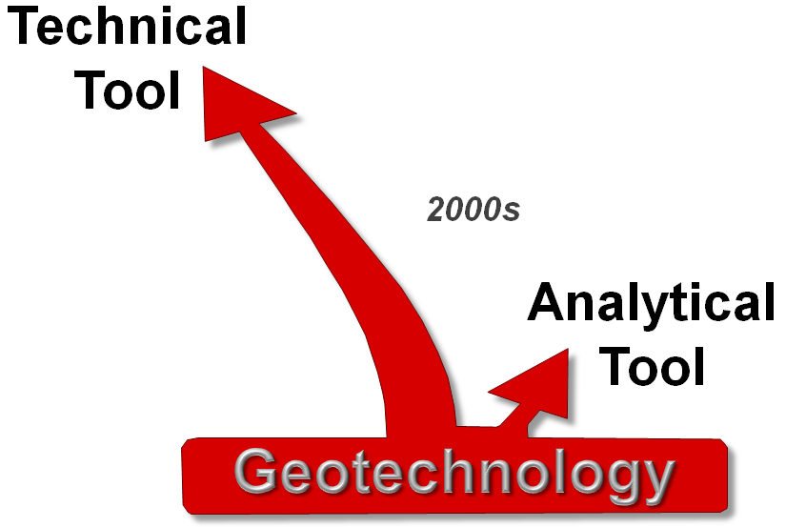
Making a Case for Map-ematics (analytical tool)
The lion’s share of GIS’s growth has been in ever expanding capabilities as a “technical tool” for corralling vast amounts of spatial data and providing near instantaneous access to remote sensing images, GPS navigation, interactive maps, asset management records, geo-queries and awesome displays. In just forty years GIS has morphed from boxes of cards passed through a window, to today’s sizzle of a 3D fly-through rendering of terrain anywhere in the world with back-dropped imagery and semi-transparent map layers draped on top—
all pushed from the cloud to a GPS enabled tablet or smart phone. What a ride!!!
However, GIS as an “analytical tool” hasn’t experienced the same meteoric rise—
in fact it might be argued that the analytic side of GIS has
somewhat stalled over the last decade.
Over 35 years of teaching graduate courses and professional workshops in grid-based map analysis and modeling has lead me
to believe that there is…
a “map-ematics” that extends traditional math/stat concepts and procedures for quantitative analysis of mapped data.
The premise is that “maps are numbers first, pictures later” and we do mathematical things to mapped data that moves GIS from
“Where is What” graphical inventories to a
“Why, So What and What If” problem solving environment—
“Thinking with Maps”

Slide 3
The “-ists” and the “-ologists”
Together the “-ists” and the “-ologists” frame and develop the Solution for an application
The “-ists”
The “-ologists”
— and —
…understand the “tools” that can be used to display, query and analyze spatial data
Data and Information
focus
…understand the “science” behind spatial relationships that can be used for decision-making
Knowledge and Wisdom
focus
Application Space
Geotechnology’s Core
“-ists”
“-ologists”
Solution
Space
Technology
Experts
Domain
Experts
GIS Expertise
Spatial Reasoning
Where is What
Why, So What, What If

Slide 4
The “-ists” and the “-ologists” (a bigger tent)
Decision Makers utilize the Solution
…under Stakeholder, Policy & Public auspices
“Policy Makers”
“Stakeholders”
“Decision Makers”
Application Space
Geotechnology’s Core
“-ists”
“-ologists”
Solution
Space
Technology
Experts
Domain
Experts
We are simultaneously trivializing…
…and complicating GIS Technology

Slide 5
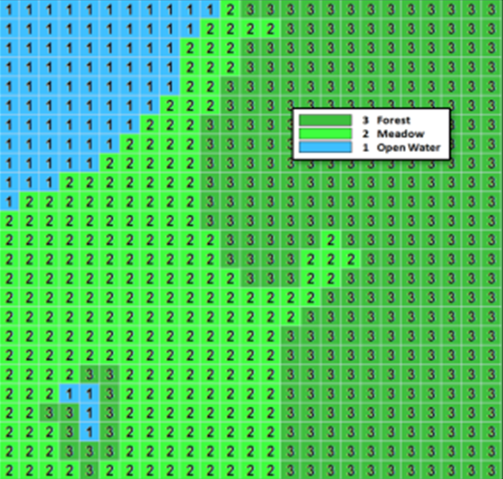
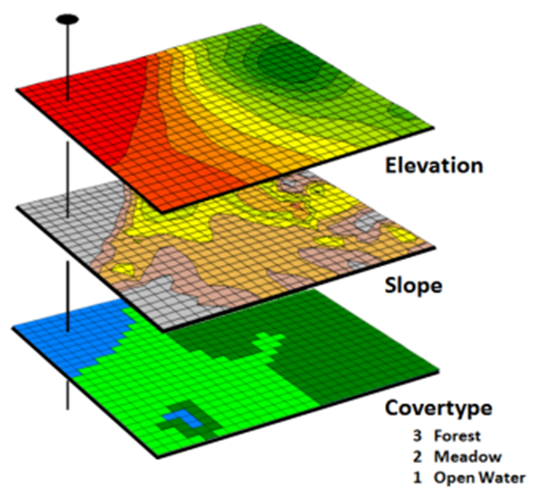
Spatial Analysis Operations (Geographic Context)
GIS as a “Technical Tool” (Where is What) vs. an “Analytical Tool” (Why, So What and What if)
Grid Layer
Spatial Analysis
Map Stack
GIS Perspective:
Reclassify (Position, Value, Size, Shape, Contiguity)
Overlay (Location-specific, Region-wide, Map-wide)
Distance (Distance, Proximity, Movement, Optimal Path, Visual Exposure)
Neighbors (Characterizing Surface Configuration, Summarizing Values)
Mathematical Perspective:
Basic GridMath & Map Algebra ( + - * / )
Advanced GridMath (Math, Trig, Logical Functions)
Map Calculus (Spatial Derivative, Spatial Integral)
Map Geometry (Euclidian Proximity, Narrowness, Effective Proximity)
Plane Geometry Connectivity (Optimal Path, Optimal Path Density)
Solid Geometry Connectivity (Viewshed, Visual Exposure)
Unique Map Analytics (Contiguity, Size/Shape/Integrity, Masking, Profile)
Map Analysis
Toolbox

Slide 6
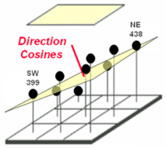
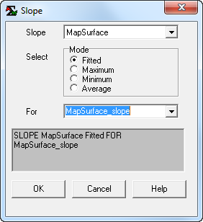
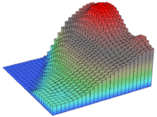
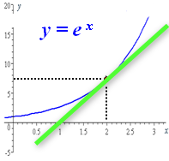
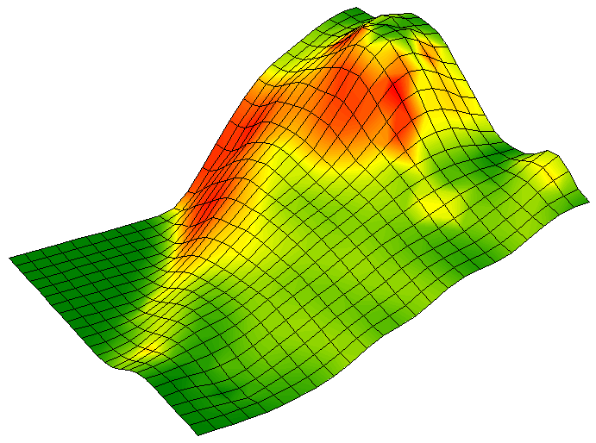
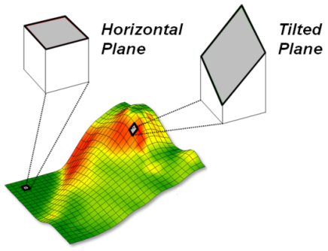
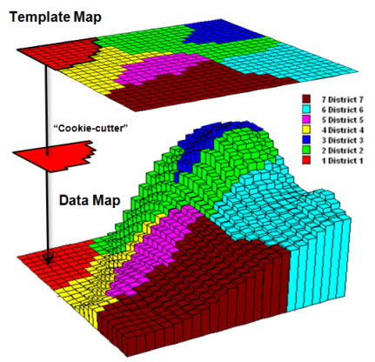
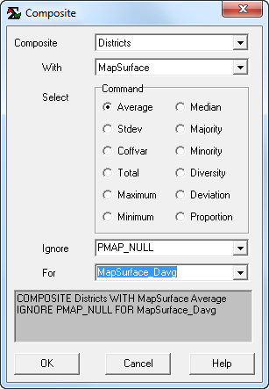
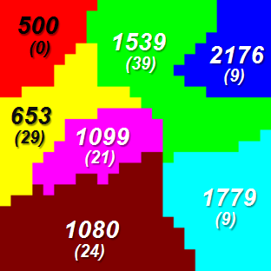
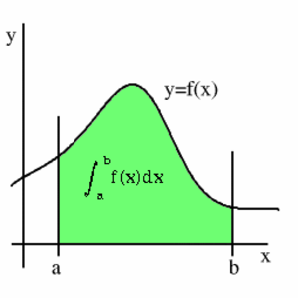
Spatial Analysis Operations (Math Examples)
Advanced Grid Math — Math, Trig, Logical Functions
Map Calculus — Spatial Derivative, Spatial Integral
Spatial Derivative
MapSurface
The derivative is the instantaneous “rate of change” of a function and is equivalent to the slope of the tangent line at a point
…is equivalent to the slope of the tangent plane at a location
2500
500
Surface
65%
Fitted Plane
Slope draped over
MapSurface
SLOPE MapSurface Fitted
FOR MapSurface_slope
Curve
0%
D_{z}xy Elevation
Advanced Grid Math
ʃ _{Districts_Average} Elevation
Spatial Integral
Surface Area
…summarizes the values on a surface for specified map areas
(Total= volume under the surface)
…increases with increasing inclination as a Trig function of the cosine of the
Slope Angle
SArea=
Fn(Slope)
MapSurface Davg
y = fn(x)
The integral calculates the area under the curve for any section of a function.
Surface
Curve
COMPOSITE Districts WITH MapSurface Average FOR MapSurface_Davg

Slide 7
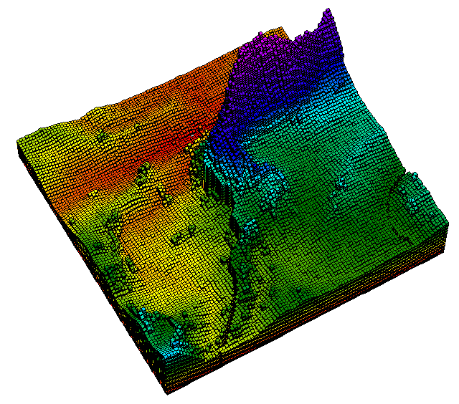
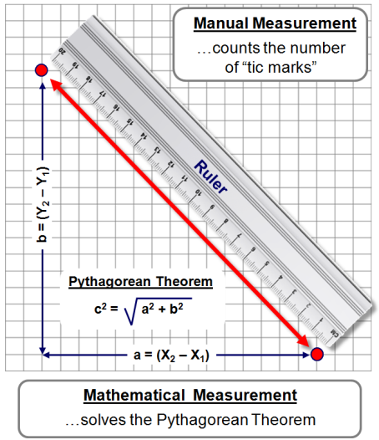
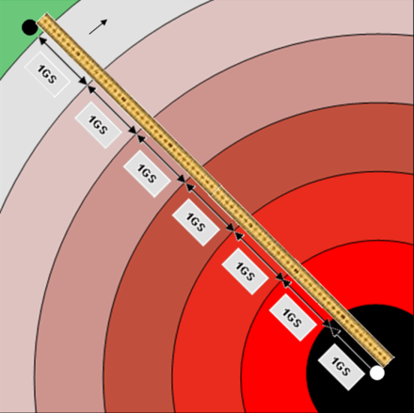
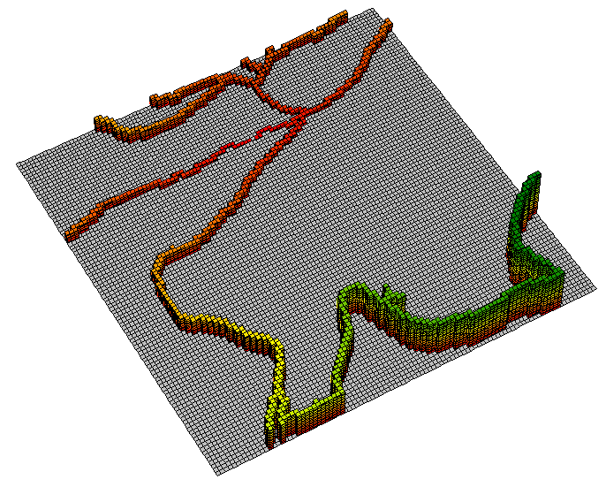
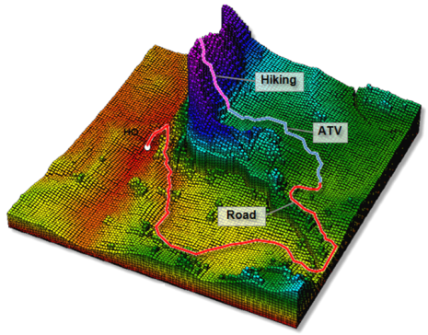
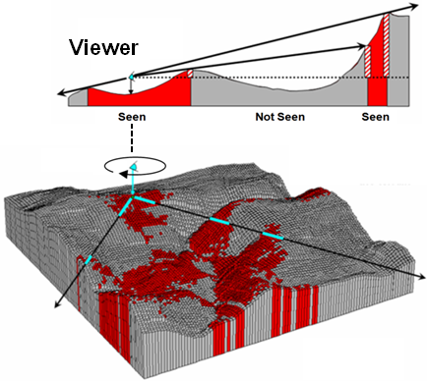
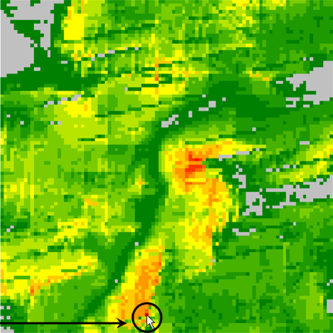
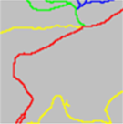
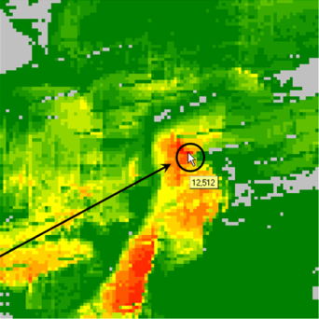
Spatial Analysis Operations (Distance Examples)
96.0 minutes
…farthest away by truck, ATV and hiking
Map Geometry — (Euclidian Proximity, Narrowness, Effective Proximity)
Plane Geometry Connectivity — (Optimal Path, Optimal Path Density)
Solid Geometry Connectivity — (Viewshed, Visual Exposure)
Distance
Euclidean Proximity
Effective Proximity
Off Road
Relative Barriers
HQ (start)
On Road
“Splash”
“Travel-Time”
Off Road
Absolute Barrier
26.5
minutes
…farthest away
by truck
On + Off
Road
Farthest
(end)
Plane Geometry
Connectivity
HQ
(start)
Shortest straight line between two points…
…from a point to
everywhere…
…not necessarily straight lines (movement)
…the “steepest
downhill path”
identifies the
optimal route
(Quickest)
Tan = Rise/Run
Rise
Solid Geometry
Connectivity
Roads
Run
Seen if new tangent exceeds all previous tangents along the line of sight
← Counts
# Viewer cells
Sums
Viewer
Weights →
270/621= 43%
of the entire road network connected
“Visual
Exposure”
Viewshed
“Splash”
Highest
Exposure

Slide 8
Spatial Statistics Operations (Numeric Context)
GIS as a “Technical Tool” (Where is What) vs. an “Analytical Tool” (Why, So What and What if)
Grid Layer
Spatial Statistics
Map Stack
GIS Perspective:
Surface Modeling (Density Analysis, Spatial Interpolation, Map Generalization)
Spatial Data Mining (Descriptive, Predictive, Prescriptive)
Statistical Perspective:
Basic Descriptive Statistics (Min, Max, Median, Mean, StDev, etc.)
Basic Classification (Reclassify, Contouring, Normalization)
Map Comparison (Joint Coincidence, Statistical Tests)
Unique Map Statistics (Roving Window and Regional Summaries)
Surface Modeling (Density Analysis, Spatial Interpolation)
Advanced Classification (Map Similarity, Maximum Likelihood, Clustering)
Predictive Statistics (Map Correlation/Regression, Data Mining Engines)
Map Analysis
Toolbox

Slide 9
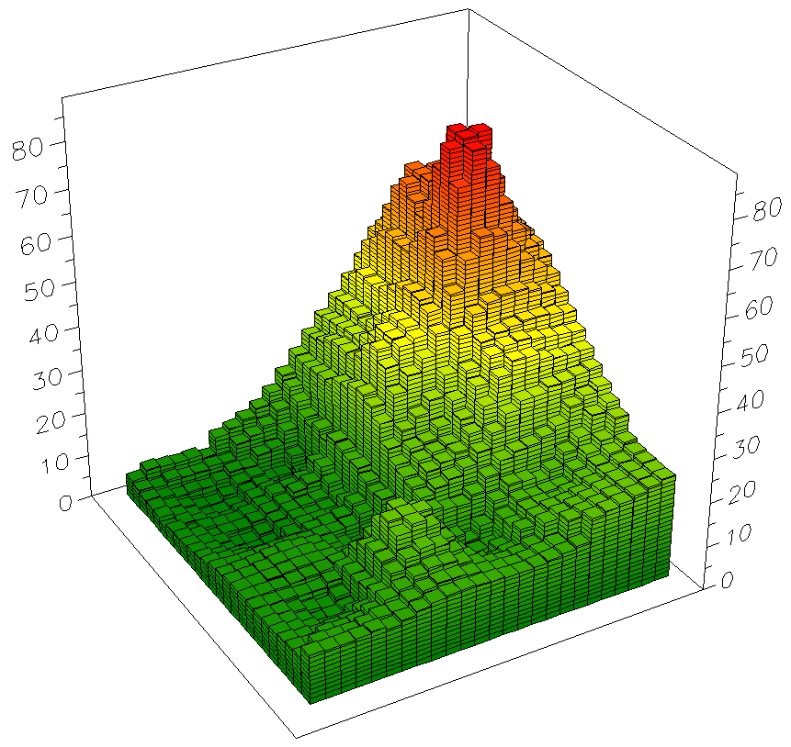
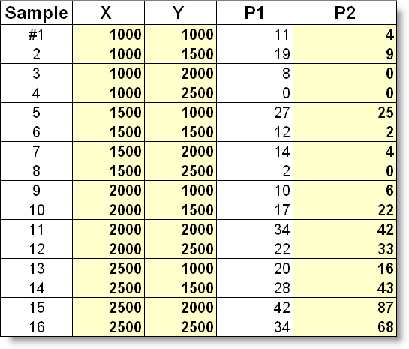
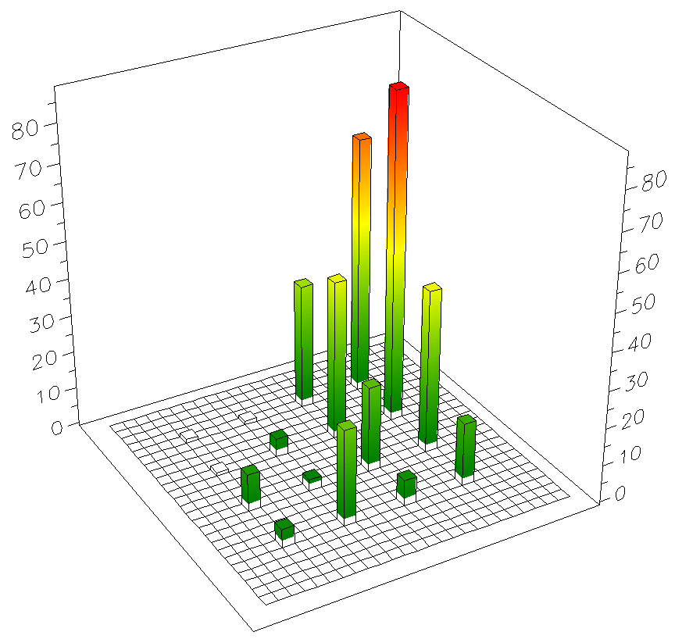
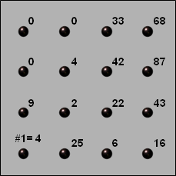
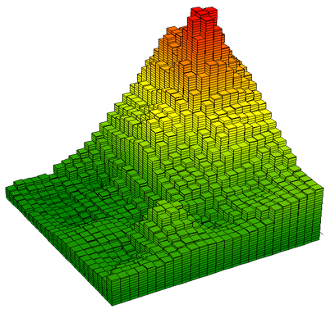
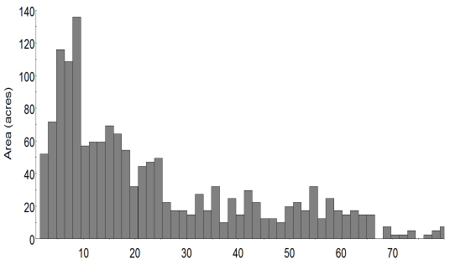
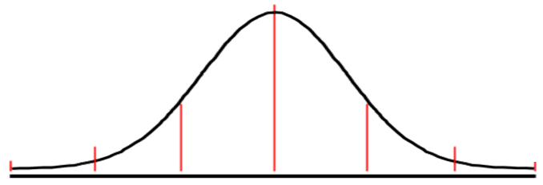
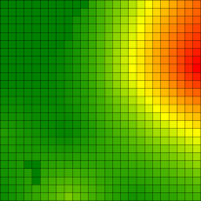
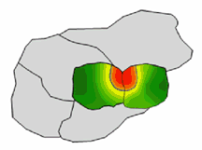
Spatial Statistics (Linking Data Space with Geographic Space)
Geo-registered Sample Data
Roving Window (weighted average)
Continuous
Map Surface
Spatial
Statistics
Discrete
Samplet Map
What
is
Where
Surface
Modeling
What
Non-Spatial Statistics
Surface Modeling techniques are used to derive a continuous map surface from discrete point data– fits a Surface to the data.
Standard Normal Curve
…NE locations are “unusually” high
Average = 22.6
Geographic Distribution
X + 1SD
= 48.8
StDev = 26.2
In Geographic Space, the typical value forms a horizontal plane implying the average is everywhere
StDev= 26.2
X= 22.6
Histogram
Numeric Distribution
In Data Space, a standard normal curve can be fitted to data to identify the “typical value” (average)
+StDev
0
10
20
30
40
50
60
70
80
Average

Slide 10
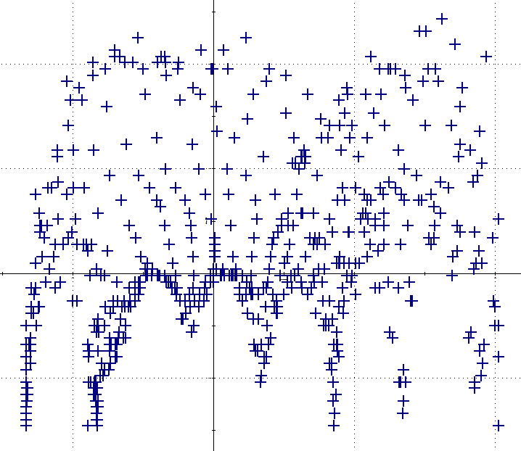
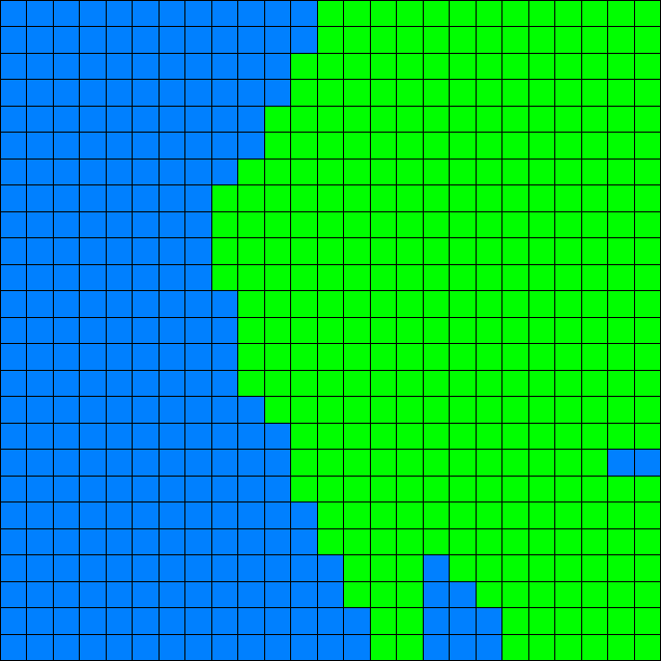
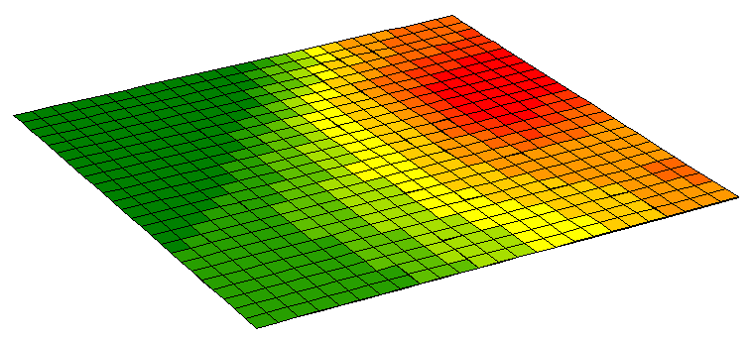
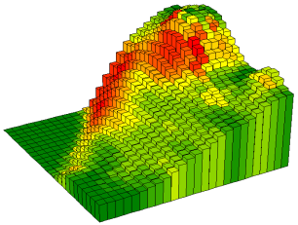
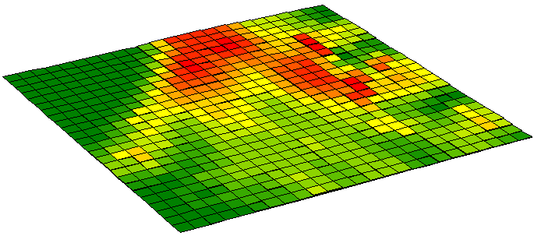
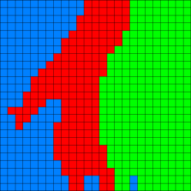
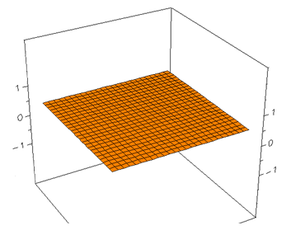
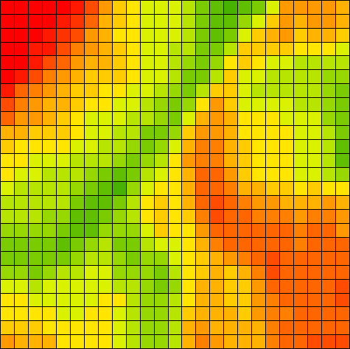
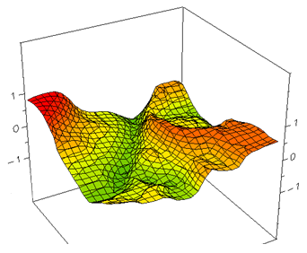
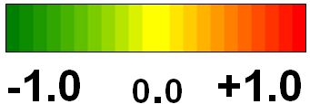
Spatial Statistics Operations (Data Mining Examples)
Map Clustering:
Elevation vs. Slope Scatterplot
…relatively High,Steep
Cluster 2
…data pairs are grouped into
similar response patterns—
C1= Low, Low
C2= High, High
Cluster 1
Cluster 2
Cluster 3
Elevation
(Feet)
Slope
(Percent)
Slope draped
on Elevation
Slope →
Cluster 1
Two Clusters
Elevation →
Three Clusters
Data Space
Geographic Space
Map Correlation:
Spatially Aggregated Correlation:
Scalar Value – one value represents the overall non-spatial relationship between the two map surfaces
Roving
Window
= 625 map values for map wide summary
=1 large data table
with 25rows x 25 columns
Entire Map
Elevation
(Feet)
r =
r = .432 Aggregated
…where x = Elevation value and y = Slope value
and n = number of value pairs
Slope
(Percent)
… 81map values for
localized summary
= 625 small data tables within 5 cell reach per table
Localized Correlation:
Map Variable – continuous quantitative surface represents the localized spatial relationship between the two map surfaces
r = .562 Localized

Slide 11
The Softer Side of GIS (The NR Experience)
Spatial Reasoning, Dialog and Consensus Building
Future Directions:
“Publics”
Social Acceptability
as 3rd filter/rail
But Social Acceptability has become the critical third filter needed for successful decision-making.
“Regulators”
“Policy-makers”
“Stakeholders”
“Decision-makers”
Banquet Table
Historically Ecosystem Sustainability and Economic Viability have dominated Natural Resources discussion, policy and management.
Podium
Inter-disciplinary Science
Team Table
“-ists”
“-ologists”
1970s
Increasing Social Science & Diverse Involvement
2010s

Slide 12
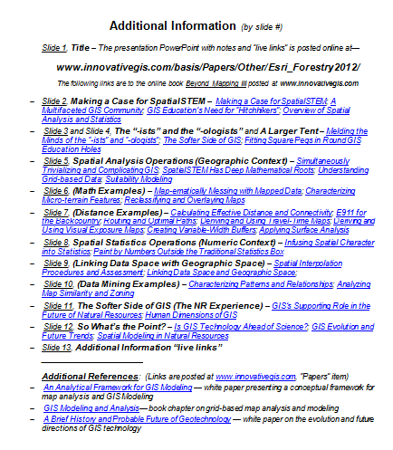
So What’s the Point?
1) Current GIS education in NR for the most part insists that non-GIS students/professionals interested in understanding map analysis and modeling must be tracked into general GIS offerings that are primarily designed for GIS specialists, and that the material presented primarily focus on commercial GIS software mechanics that GIS-specialists need to know for the workplace.
2) However, solutions to complex spatial problems need to engage “domain expertise” in GIS–
outreach to other disciplines to establish spatial reasoning skills needed for effective solutions that integrate a multitude of disciplinary and general public perspectives.
3) Grid-based map analysis and modeling involving Spatial Analysis and Spatial Statistics is in large part, simply extensions of traditional mathematics and
statistics concepts and procedures.
Handout
www.innovativegis.com/basis/Papers/Other/Esri_Forestry2012/
4) Two paradigm shifts are needed— recognition by the GIS community that quantitative analysis of maps is a reality, and…
…recognition by the STEM community that spatial relationships exist and are quantifiable.

Slide 13
Notes:
Company branding slide

